Slide 1


Improving Destination Choice for Work Trips
Supervisors
Tanja Hardt - Johan Los
Soora Rasouli - Valeria Caiati
Yasaman Eslamijadidi
Notes:
Good afternoon. Thank you for being here today. My name is Yasaman, and I will be presenting my Master’s thesis, which focuses on improving destination choice models by incorporating more detailed variables and specifications.

Slide 2
Table of contents
01
02
03
Introduction
Theory
04
05
Findings
Discussion
Acknowledgement
Methodology
Context and Octavius framework
Theoretical Foundation and Research Approaches
Research Design and Data Preparation
06
Results and Model Performance
Discussion, Limitations and Future Directions

Slide 3
01.
Introduction
Context and the Octavius framework

Slide 4

OmniTrans
Context
In a densely populated country like the Netherlands, rapid urbanization, economic growth, and shifting travel patterns, especially in the post-Covid era, create a strong need for advanced tools to support effective policy and infrastructure planning.
Notes:
The motivation behind this work lies in the increasing complexity of travel behavior in the Netherlands, with urbanization, economic growth, and changing patterns after COVID-19. That require advanced tools for policy evaluation and infrastructure planning.

Slide 5
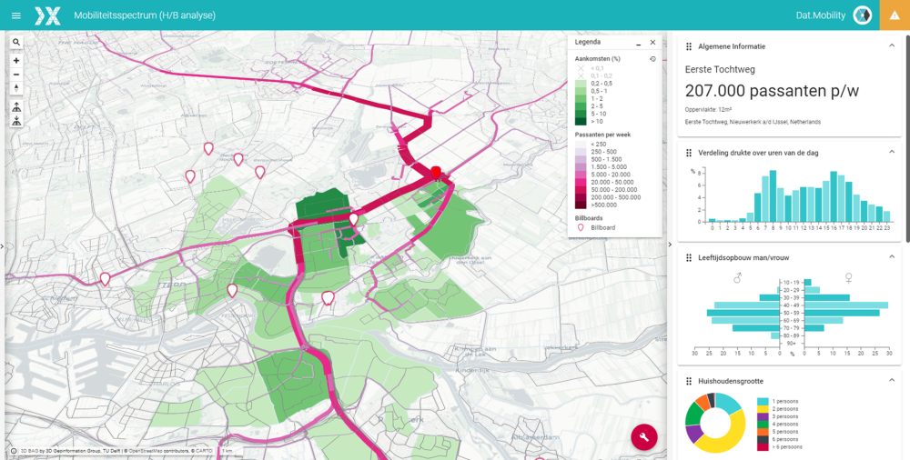
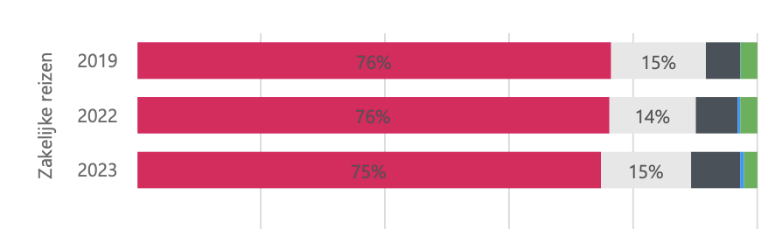
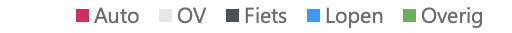
Travel Demand
Models
Predict travel patterns in a geographic context that reflect real-world behavior.
Source: Landelijk Reizigersonderzoek 2023 (van Essen et al., 2024)
Notes:
Travel demand models are designed to predict travel patterns in a geographical context and to replicate reality as closely as possible. Beyond the models, simulation packages can assign these predicted travel patterns to the transport network, which makes them powerful tools for policy analysis and infrastructure planning.
For this study, the main focus is on improving the prediction of work trips by car t. Since 2019, the car has consistently held the largest share of work trips, and it continues to be the dominant mode today. This makes it particularly important to capture car-based work travel as accurately as possible.

Slide 6
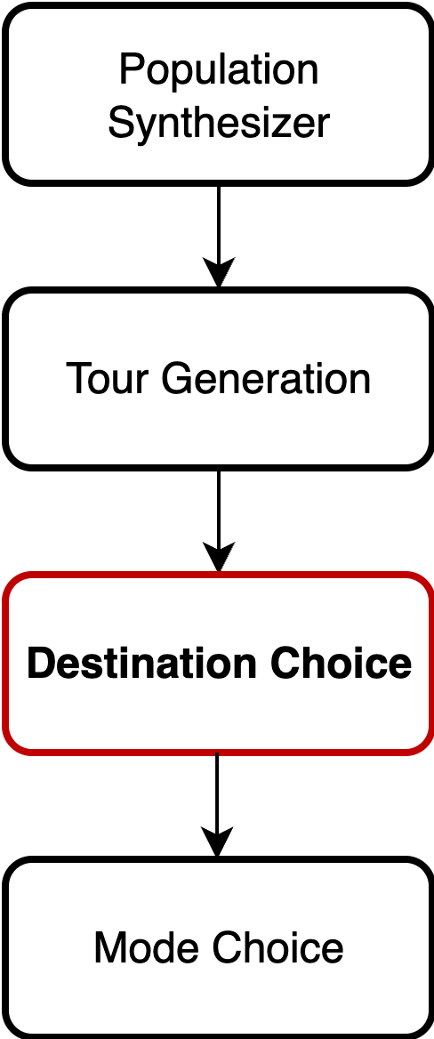
Octavius Framework
Population Synthesizer
Generates synthetic individuals & households per zone 180 person types and 216 household types
Tour Generation
Predicts daily tours (0–3) with primary/secondary purposes
Destination Choice
Assigns zones to trips (conditional on origin, mode, tour type) 26 main destination models (mode × purpose)
Mode Choice
Chooses travel mode per tour via MNL models
Notes:
Octavius follows a four-step framework to model travel behavior:
First, the Population Synthesizer generates synthetic individuals and households for each zone, considering 180 person types and 216 household types.
Second, Tour Generation predicts daily tours, sequences of the trips
Third, the Destination Choice module assigns zones to each trip, conditional on the tour type, mode, and origin. There are 26 main destination choice models for different mode, purpose combinations. This module is the main focus of my study, as it determines where people go for work trips.
Finally, Mode Choice determines the travel mode for each tour using multinomial logit models.”

Slide 7
Research Objectives
How can destination choice models for car-based work trips be improved to enhance predictive accuracy while remaining computationally feasible for large-scale planning?
Variable Identification
Model Specification
Data Integration
Performance Evaluation
Notes:
The main research question of this study asks how destination choice models for car-based work trips can be improved to enhance predictive accuracy, while remaining computationally feasible for large-scale planning.
The main problem over reliance of the current models on total number of jobs in a zone as the only attraction variable that can lead to overassignment of the flows to already polular destinations.
To answer this question, the study focuses on four key objectives:
First, to identify relevant explanatory variables that capture travel behavior accurately.
Second, to specify an appropriate destination choice model that balances realism and simplicity.
Third, to integrate multiple data sources, including demographic and travel survey data, to better represent the population.
Finally, to evaluate the model performance, both in-sample and out-of-sample, to ensure reliability for planning applications.”

Slide 8
02.
Theory
Theoretical Foundation and Research Methodology

Slide 9
Evolution of Travel Demand Models
Data-driven, ML models
Aggregated
four-step
models
Disaggregated choice-based
models
Activity-Based models
1970s-1990s
1990s-2000s
2000s-Present
Most
Recent
Notes:
Initially, aggregated four-step models focused on predicting flows between zones without capturing individual choices.
Next, disaggregated choice-based models allowed for modeling individual decision-making, introducing more behavioral realism.
Activity-based models further advanced this by simulating sequences of trips and activities over the day, capturing interactions between trips.
Most recently, data-driven and machine learning approaches have emerged, using large datasets to learn travel patterns directly, often improving predictive accuracy but sometimes sacrificing interpretability.

Slide 10
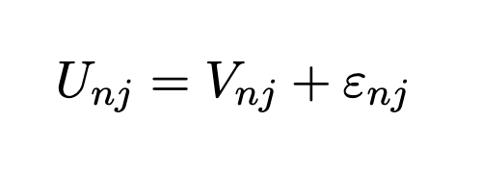
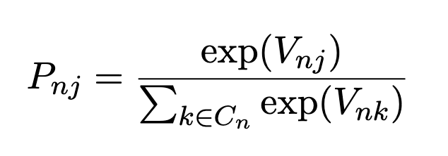
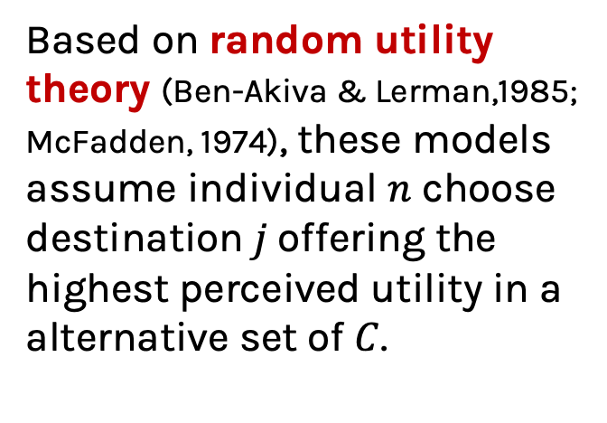
Theoretical Framework
Choice-based models
Based on random utility theory (Ben-Akiva & Lerman,1985; McFadden, 1974), these models assume individual $n$ choose destination$j$offering the highest perceived utility in a alternative set of $C$.
Multinomial Logit Model
Parameters estimated using Maximum Likelihood
Notes:
This study uses Multinomial Logit models, grounded in Random Utility Theory. According to this theory, individuals choose the destination that offers the highest perceived utility among all alternatives
The utility of choosing destination j for i is expressed … where … is the systematic part that we can model with observed variables, and ….is the random error term capturing unobserved factors.
The probability of individual n choosing destination j is then given by the familiar MNL formula:…
Finally, the model parameters are estimated using the Maximum Likelihood procedure, which finds the values that maximize the likelihood of observing the choices in our data.

Slide 11
Destination Choice models
Explanatory Variables of Destination Choice
Challenges in practice
• Travel Impedance
Travel time, travel cost and combinations • Destination attractions
e.g., jobs, services, number of residence • Socio-demographics
e.g., gender, age, household composition, income
• IIA assumption
spatial correlation​ • Choice set formation
(awareness, feasible options)​ • Capacity constraints
at destinations​ • Computational complexity in large networks
Notes:
When using MNL for destination choice models
Destination choice models include three main types of variables: travel impedance, destination attractions, and socio-demographics.
In practice, challenges arise from the IIA assumption and spatial correlation, forming realistic choice sets, capacity constraints at destinations, and computational complexity in large networks.

Slide 12
Work Trips Application
Theoretical framework
Sector-mix log-sum
Nonlinear distance decay & accessibility logsums
(Mishra, 2013)
(Daly, 1982)
Mixed and Nested Logit
Sector Specific job counts
(Gupta, 2015)
Discrete choice Framework
(Train, 2009), (Dong et al., 2006)
Flexible work arrangements
Shadow Prices
(Van Lent, 2025)
(Vitins et al. (2016, 2023))
Household effects
(Gupta, 2015)
Notes:
In the application to work trips, several extensions were used to improve prediction accuracy.
These include sector mix log-sums and sector-specific job counts to capture the attractiveness of destinations. Flexible work arrangements and household effects account for individual and household behavior in trip making.
For smaller networks, nonlinear distance decay functions were applied, and mixed and nested logit models were tested to account for heterogeneity and correlation across alternatives.
Finally, shadow prices were used to enforce capacity constraints at destinations, preventing unrealistic concentration of trips (Vitins et al., 2016; Train, 2009).

Slide 13
03.
Methodology
Research Design and Data Preparation

Slide 14
Research Design
Work Flexibility
Indicates whether an individual has the option to work from home.
Sector job share
The proportion of jobs in a specific sector within a zone relative to the total number of jobs in that zone.
Extended Model
Additional variables: Sector specific job shares,
work flexibility and existence of a child
Base Model
Current Octavius Replica
Notes:
This study estimates two models for work trips for faily compare the suggested improvements.
The baseline model replicates the current Octavius setup, serving as a reference.
The extended model introduces additional sector-specific variables, which will be described in more detail in the following slides. This allows us to evaluate whether including these variables improves predictive accuracy.

Slide 15
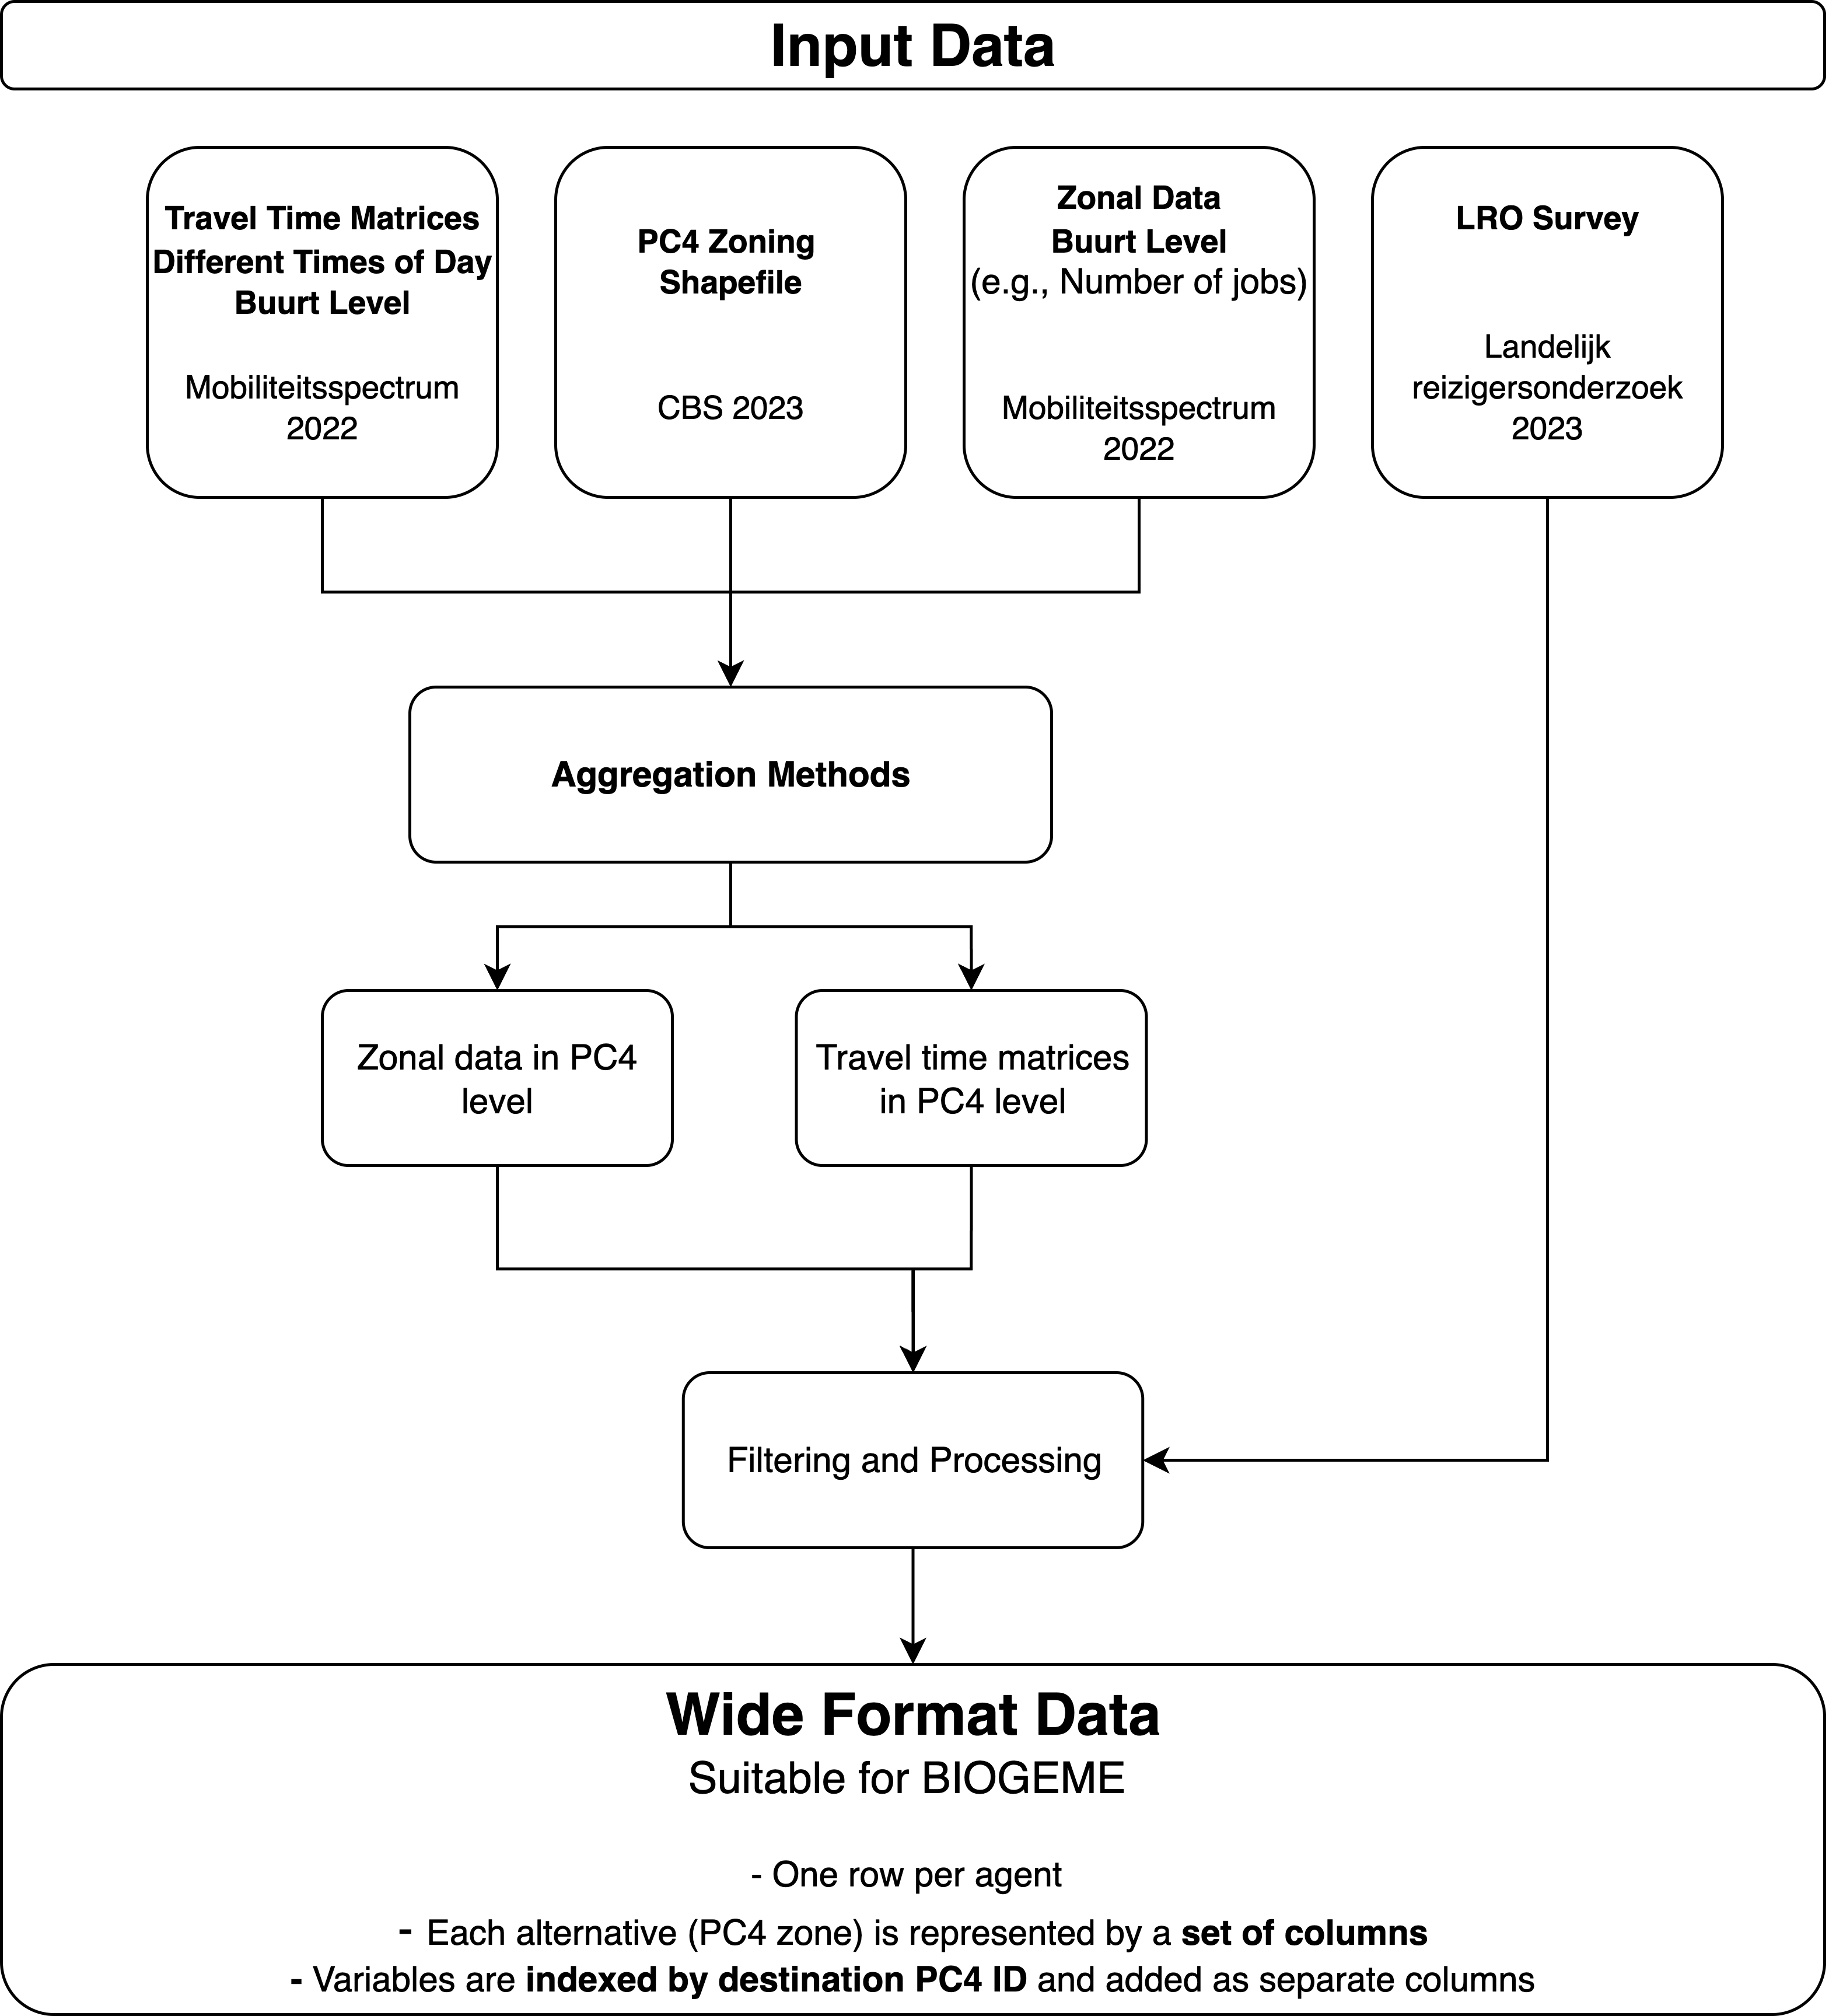
Data Preparation Overview
PC4 Level
Landelijk Reizigersonderzoek (2023)
national travel survey
CBS PC4 Zoning Data (2023)
Neighbourhood Level
Zonal Data (2022)
e.g., Number of jobs per zone
Travel Time matrices (2022)
Notes:
For this study, four main datasets were used and prepared to be in a right format for estimation process.
The LRO national survey provides travel behavior information at the PC4 level.
Zonal data and travel time matrices were provided in neighbourhood level that they needed to be combined and aggregated appropriately to prepare inputs for the baseline and extended destination choice models.

Slide 16
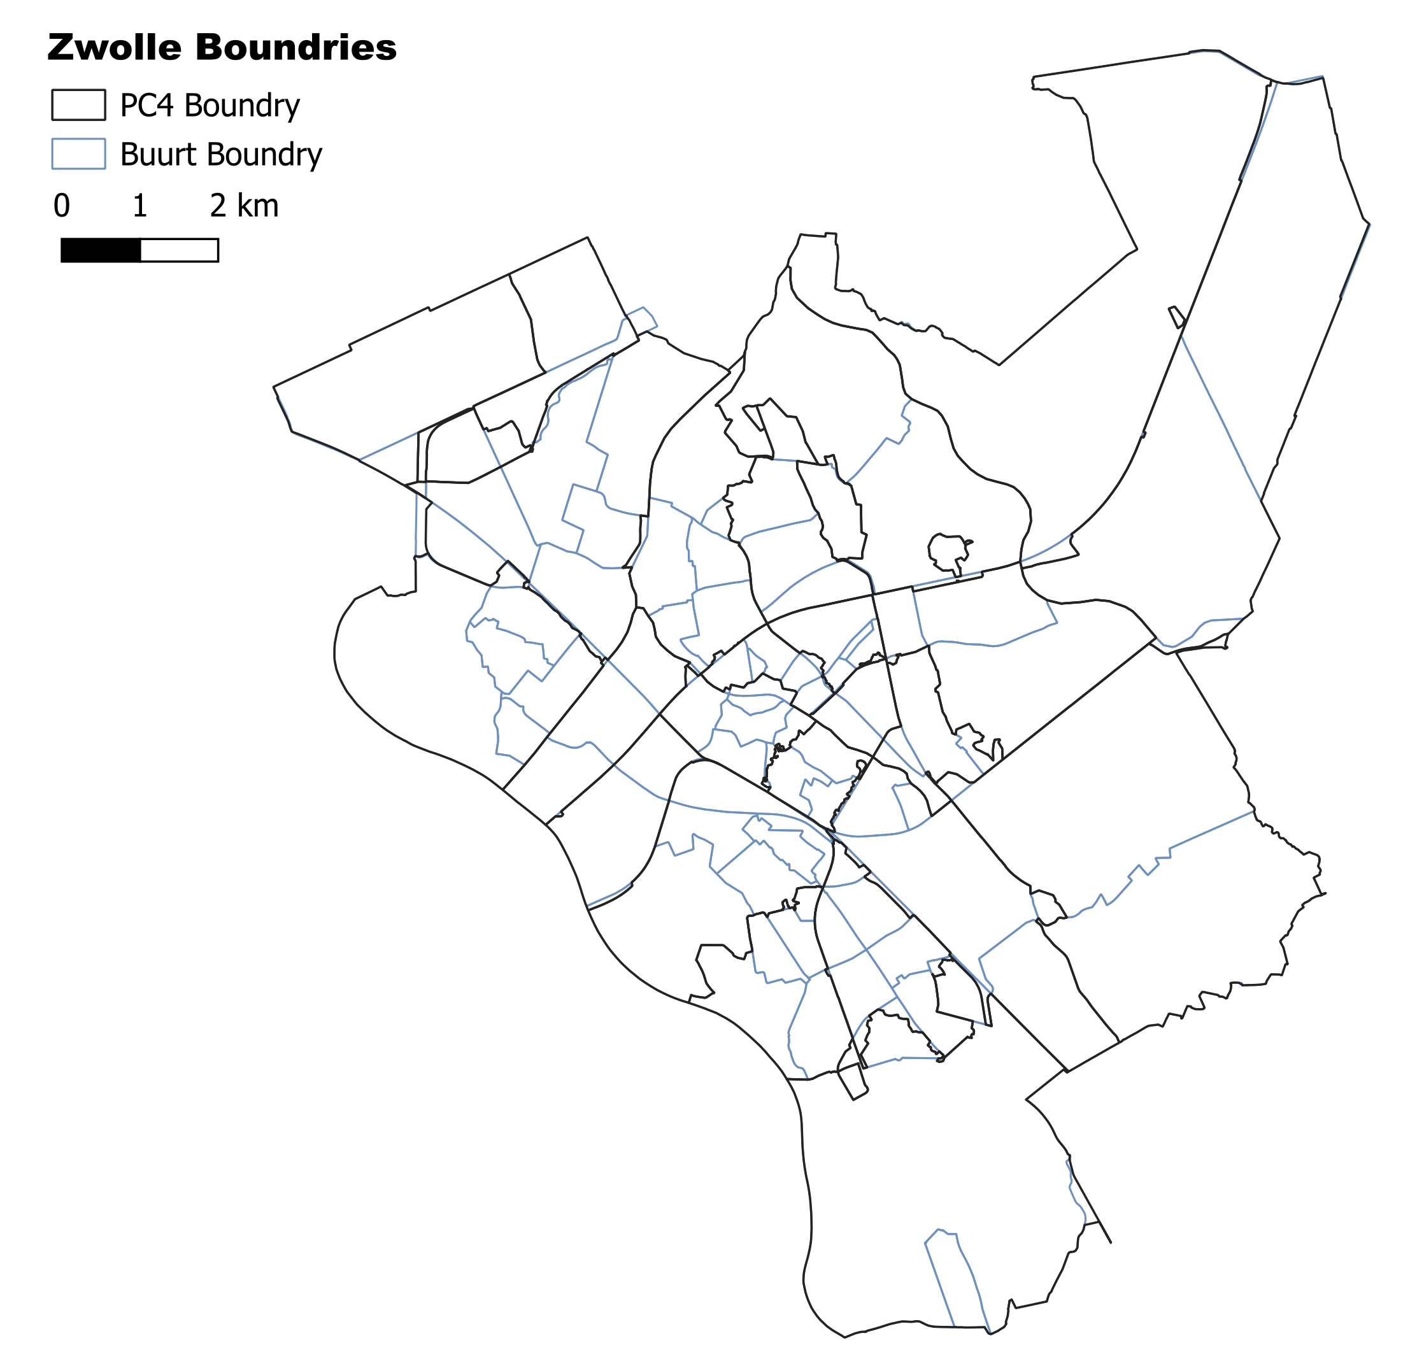
Data Preparation Aggregation challenges
Neighbourhood (Buurt) level with 14,422 zones
PC4 level with 4,071 zones
(Centraal Bureau voor de Statistiek (CBS), 2024)
Notes:
During data preparation, some aggregation challenges arose.
First, the hierarchy of zones was not always consistent: PC4 zones are larger than neighborhoods, but in some cases this relationship did not hold.
Second, some neighborhoods were located within multiple PC4 zones. In these cases, the neighborhood was assigned to the PC4 zone with the largest centroid overlap.
Despite these adjustments, 151 PC4 zones had to be excluded because they had no corresponding neighborhood data. This ensured that all included zones had complete and consistent information for the models.

Slide 17
Work Sector Variables
Zonal Jobs | Work sector | Count | %
Healthcare jobs | Health and welfare | 637 | 25.1
Education jobs | Education | 250 | 9.8
Retail jobs | Commerce | 206 | 8.1
Office jobs | Business services | 154 | 6.1
 | Public administration | 128 | 5.0
 | ICT | 116 | 4.6
 | Financial services | 97 | 3.8
Industry jobs | Construction | 89 | 3.5
 | Industry | 289 | 11.4
 | Transportation | 79 | 3.1
Remaining jobs | Agriculture / fishery | 38 | 1.5
 | Utilities | 12 | 0.5
 | Other services | 385 | 15.2
Hospitality & Culture jobs | Culture | 31 | 1.2
 | Hospitality | 39 | 1.3
2,550 total respondents filtered on
Those who travel to work at least once a week by car
After removing missing values:
Train set: 1983 agents
Test set: 495 agents
Notes:
The work sector data from the LRO survey was initially unbalanced and did not perfectly align with zonal CBS job counts. To address this, sectors were aggregated to conform to the zonal data, allowing us to compute interacted job shares for each agent–destination pair.
The full dataset contained 2,550 respondents who travel to work at least once a week by car. After removing missing values, the training set included 1,983 agents and the test set 495 agents, which were used to estimate and validate the destination choice models.

Slide 18
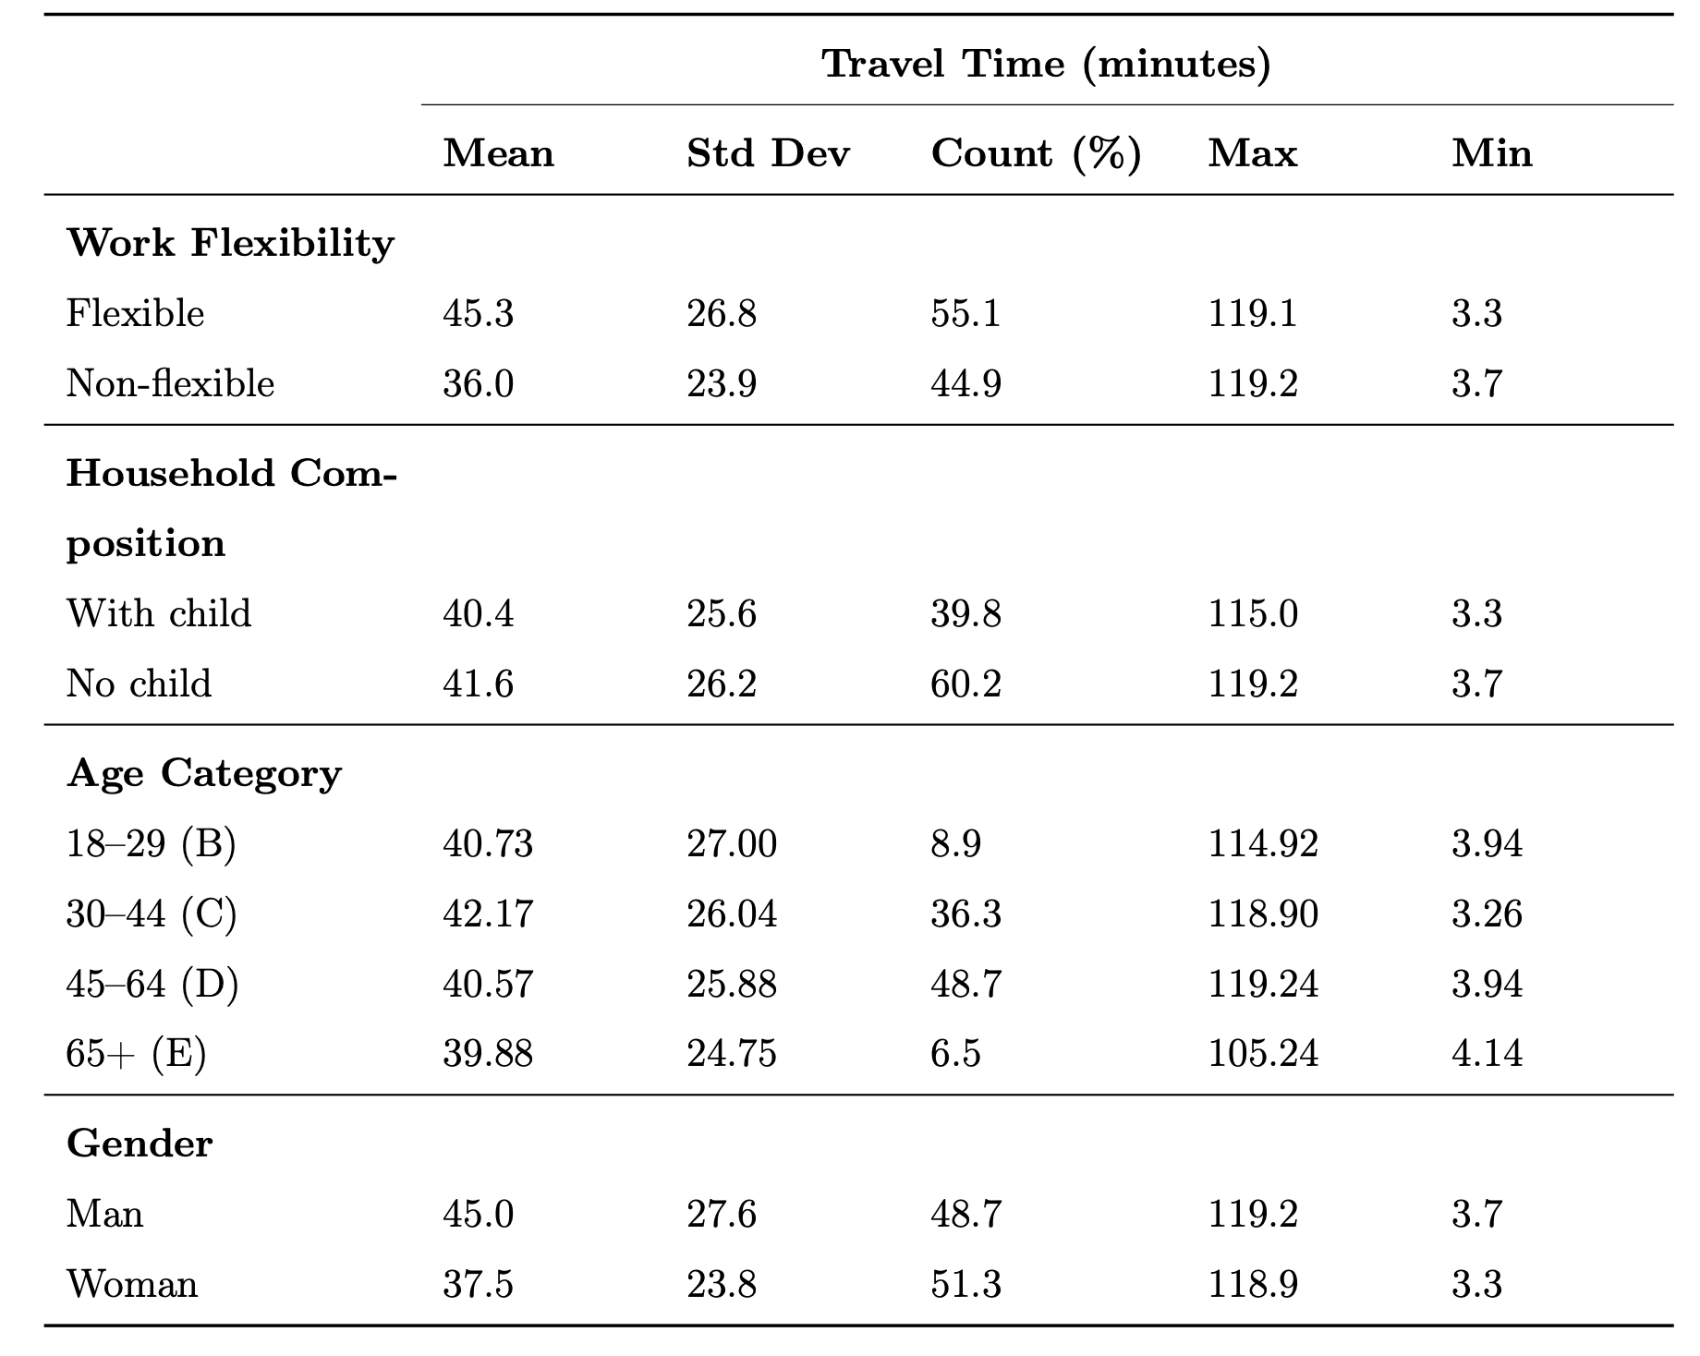
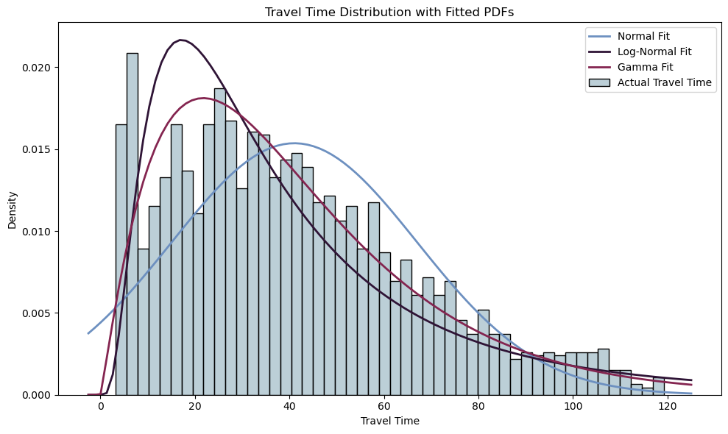
Travel Time Analysis
Notes:
“This section explores how commuting patterns vary across demographic and behavioral groups, with a focus on work flexibility, household composition, age, and gender.
What flexibility means here those that has flexibility option from their workplace to work from home, wheather they use it or not
Workers with flexible arrangements have, on average, 26% longer commutes than those without flexibility (45.3 vs. 36.0 minutes). Men commute about 20% longer than women, while differences by age or household composition are smaller.
The raw travel times are highly right-skewed, reflecting a mix of local and regional commuters. Various candidate distributions were tested, and the Gamma distribution provided the best fit. A Box-Cox analysis suggested an optimal transformation parameter λ = 0.42, between square root and logarithmic, to stabilize variance for modeling purposes.

Slide 19
Availability condition of Alternatives
Base Model
Extended Model
Travel time feasibility
160 minutes two-way
Travel time feasibility
Work sector matching
Averagely 1,465 available zones
Averagely 1,242 available zones
Notes:
Only enhanced model allows for work sector matching
Zones that have ralavant job for that agent available

Slide 20
04.
Findings
Results and Comparison

Slide 21
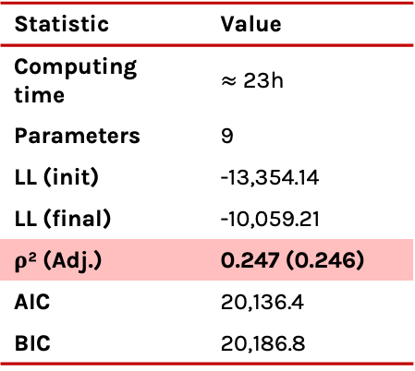
Parameter​ | Value​ | Std. Err.​ | p-value​
Size variable​ | ​ | ​ | ​
ln(Total jobs)​ | 1.0 (fixed)​ | –​ | –​
Travel time effects​ | ​ | ​ | ​
Travel time (base)​ | -0.047*​ | 0.0035​ | <0.001​
Travel time × Age 30–44​ | -0.001​ | 0.0037​ | 0.795​
Travel time × Age 45–64​ | -0.006**​ | 0.0037​ | 0.096​
Travel time × Age 65+​ | -0.010**​ | 0.0053​ | 0.060​
Travel time × Woman​ | -0.014*​ | 0.0020​ | <0.001​
Urbanity (ref: level 1)​ | ​ | ​ | ​
Level 2 (highly urban)​ | 0.196*​ | 0.079​ | 0.013​
Level 3 (moderately urban)​ | 0.270*​ | 0.076​ | <0.001​
Level 4 (low urban)​ | 0.236*​ | 0.074​ | 0.001​
Level 5 (not urban)​ | -0.409*​ | 0.088​ | <0.001​
Base model statistics​
Statistic​ | Value​
Computing time | $≈$ 23h
Parameters​ | 9​
LL (init)​ | -13,354.14​
LL (final)​ | -10,059.21​
ρ² (Adj.)​ | 0.247 (0.246)​
AIC​ | 20,136.4​
BIC​ | 20,186.8​
Notes:
This slide summarizes the results of the base model estimation.”
“As expected, the size variable – total jobs in log form – plays a strong role. By taking the log, we account for diminishing marginal returns: once a zone is already very large, additional jobs don’t make it much more attractive.”
“The coefficient is normalized to 1.0, meaning destinations with more jobs are directly more attractive.”
“Travel time shows the expected negative and significant effect. A coefficient of -0.047 reflects clear disutility for longer commutes.”
“Among the interaction terms, only gender × travel time is significant. This suggests men are more sensitive to travel time compared to women.”
“Age interactions are negative too, hinting at higher sensitivity for older workers,
“Urbanity has a consistent effect: moderately urban destinations (levels 2–4) are preferred over the very highly urban reference category, while the least urban (level 5) is unattractive.”
“In terms of fit, the model reached a final log-likelihood of about -10,059 and a rho-squared of 0.24. This is a mediocre but acceptable performance given the complexity of around 1,500 alternatives.”
“Estimation time was long – about 23 hours – which highlights the computational challenge of working with such a large choice set.

Slide 22
Parameter | Value | Std. Err. | p-value
ln(Total jobs) | 0.773* | 0.025 | <0.001
Sector-specific job shares
Care | 2.65* | 0.24 | <0.001
Education | 4.42* | 0.38 | <0.001
Hospitality/ Culture/Sports | 1.63 | 1.83 | 0.374
Industry/Construction | 1.72* | 0.22 | <0.001
Office/Services | 1.93* | 0.25 | <0.001
Shop | -0.114 | 1.02 | 0.910
Work flexibility
TT × Flexible work | 0.015* | 0.0020 | <0.001
Household composition
TT × With child | -0.0062* | 0.0021 | 0.003
Extended model statistics​
Different Specifications of Travel Time
TT Specification | Initial LL | Final LL | ρ² | AIC
Linear | -13,964.69 | -9,676.96 | 0.307 | 19,389.92
Square root | -13,964.69 | -9,724.55 | 0.303 | 19,481.10
Log | -13,964.69 | -10,040.22 | 0.281 | 20,112.44
To be continued
Notes:
The extended model improves significantly over the base specification. The final log-likelihood is minus nine thousand six hundred, with a rho-squared about twenty-four percent higher. This represents a clear gain in predictive accuracy.
For travel time, both logarithmic and square root specifications were tested, following the Box–Cox results. However, the linear form provided the best performance and was retained.
The total jobs variable is now estimated instead of fixed. Its coefficient is less than one, In practice, this means that simply counting all jobs in a zone overestimates its attractiveness. Large zones may contain jobs that are not equally reachable or relevant. Total jobs captures mass; sector share captures match.
Sectoral job shares provide strong improvements. Workers are significantly more likely to choose destinations with higher concentrations of jobs in their own sector. For example, education has the largest effect with a coefficient of four point four two, followed by care, industry and construction, and office services. These effects are all positive and statistically significant.
Also in this model, we include additional interactions with travel time. Work flexibility reduces the sensitivity to travel time, meaning flexible workers are more willing to accept longer commutes.
The presence of children increases the sensitivity to travel time. Parents are less likely to choose distant jobs, reflecting stronger constraints on daily schedules.

Slide 23
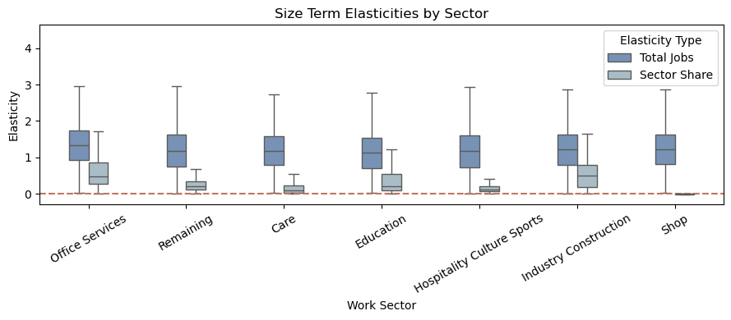
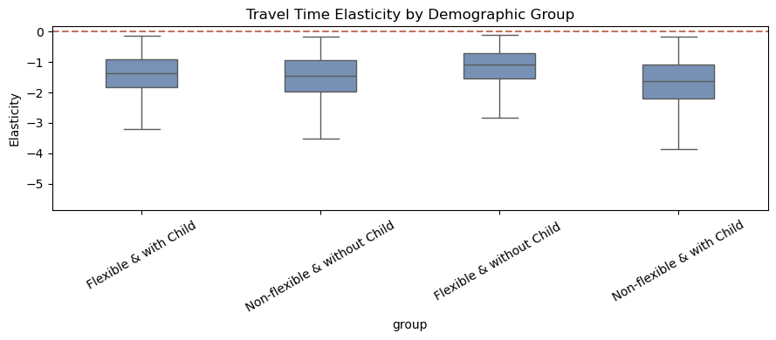
Elasticities
The percentage change in choice probabilities resulting from a 1% change in variables
Notes:
Elasticities show the relative importance of key variables. Total jobs remain dominant: a 1% increase raises the probability of choosing a destination by about 1.5 percent, reflecting diminishing returns.
Sector-specific job shares reveal heterogeneous preferences. Education (4.42) is most sensitive, followed by care, office/services, and industry. These effects are strongest where sectors are geographically concentrated. Commerce, by contrast, is more evenly spread, so the effect is weaker when specially aggregated across multiple activities like retail shops, food stores, and supermarkets
Total jobs captures mass; sector share captures match.
Travel time penalizes longer commutes in both models, but the enhanced model shows a stronger coefficient (-0.056), capturing greater overall sensitivity. Flexible workers without children are least sensitive to travel time, while non-flexible workers with children are most sensitive (-3.5), with the other groups in between.
Overall, total employment drives most choices, while sectoral matching and demographic interactions improve realism, model fit, and predictive accuracy.

Slide 24
Accuracy Metrics
 | Base | Enhanced | Improvement % | Base | Enhanced | Improvement %
 | In-sample |  |  | Out-of-sample
Avg. N of alternatives | 1,465 | 1,242 | - | 1,255 | 1,255 | -
Top-1 accuracy | 0.0740 | 0.108 | +45.9% | 0.0738 | 0.0925 | +25.4%
Top-5 accuracy | 0.2275 | 0.238 | +4.6% | 0.2233 | 0.2375 | +6.4%
Top-10 accuracy | 0.320 | 0.340 | +6.3% | 0.3125 | 0.3405 | +9.0%
City-level accuracy | 0.2732 | 0.3089 | +13.1% | 0.2875 | 0.3010 | +4.7%
Notes:
The improvements in accuracy might seem small at first glance. Top-1 accuracy increases from 7.4 to 10.8 percent in-sample and from 7.3 to 9.2 percent out-of-sample. Top-5 and Top-10 accuracy measure whether the observed destination is within the top 5 or 10 predicted alternatives, while city-level accuracy captures whether the predicted destination is in the correct municipality.
It’s important to note that in probabilistic models, there are different ways to measure fit to the data. Exact accuracy only counts a correct prediction if the highest-probability alternative exactly matches the chosen destination. In a spatial context, where many alternatives are correlated or close together, hitting the exact alternative is very difficult. That’s why broader measures like Top-5, Top-10, or city-level accuracy are used. More complex metrics could also account for how the model distributes probability across chosen destinations, not just the top choice.
These values are modest because each agent faces around 1,200 alternatives. By comparison, other studies with smaller choice sets of about 100 alternatives typically achieve around 30 percent Top-1 accuracy. Despite this, the enhanced model shows consistent relative improvements and maintains performance out-of-sample.
The zone with highest assigned probability is within the city of the chosen destination

Slide 25
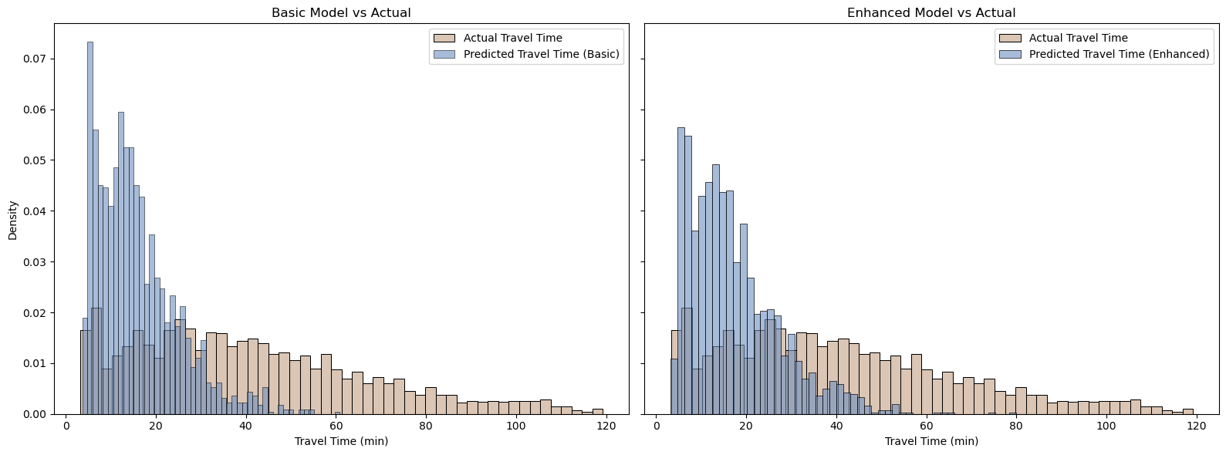
Distribution of Predicted travel time
Notes:
Why they’re both bad.
In both models, the predicted distribution of travel times is noticeably weaker compared to the actual observed data, particularly for longer commutes.
The base model peaks sharply around 15 to 25 minutes and declines too quickly, meaning it essentially fails to represent medium- and long-distance commuters.
The enhanced model does a better job: the decline is smoother, the right tail is longer, and the mean and median values are closer to the observed distribution. One reason for this improvement is the work flexibility interaction. Its positive coefficient with travel time means that flexible workers are more willing to accept longer commutes compared to the average worker. This allows the model to better capture longer trips, which are underrepresented in the base model.
Still, both models underestimate the frequency of very long commutes. This opens up room for improvement, especially in how travel time is specified in the model and how heterogeneity in commuting behavior is captured.
Nearest optimal solution

Slide 26
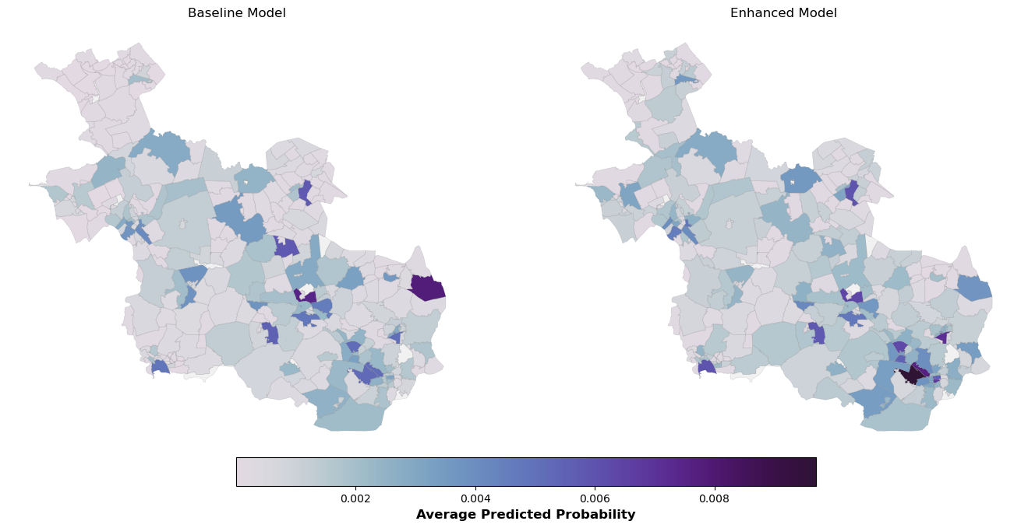
Average Predicted Probabalities - Overijssel
Base Model
Extended Model
Notes:
This figures shows the average predicted workplace probabilities across zones in Overijssel. Probabilities are calculated only for feasible alternatives for each agent, meaning those zones available in their choice set.
In both models, the main cities receive the highest probabilities, reflecting the concentration of jobs in urban areas. However, the enhanced model distributes nonzero probabilities across a wider set of zones. This happens because sector-specific job shares allows the model to identify additional relevant opportunities for agents in different sectors.
As a result, the enhanced model produces a more realistic spatial pattern. While dominant employment centers remain prominent, the model now better represents the diversity of feasible destinations, making it more useful for policy analysis and scenario evaluation where probability assignment matters.

Slide 27
05.
Discussion
Limitations and Future directions

Slide 28
Study Limitations
Spatial Units
PC4 zones may misalign with functional travel patterns
Sector Representation
Unbalanced distribution of data across work sectors
Hidden heterogeneity within broad sectors
Choice Set Size
Too many alternatives! Unrealistic & computationally heavy
Needs systematic choice set reduction for feasibility
Notes:
This study has several limitations.
First, the spatial units. Using PC4 administrative zones may misalign model alternatives with how agents actually perceive or use space. Administrative boundaries often fragment functionally integrated areas, creating alternatives that appear distinct in the model but not to real decision-makers. Aggregation can also introduce errors.
Second, sector representation. Employment is unevenly distributed across sectors, categories are over-aggregated, and broad sectors hide heterogeneity that could influence model behavior.
Finally, choice set size. With around 1,200 alternatives per agent, the choice set is very large. This increases computational demand and can produce unrealistic predictions. Systematic reduction of the choice set would improve feasibility for large-scale applications.”

Slide 29
Methodological Limitations
Higher Nests
City
Independence of Irrelevant
Alternatives
Choices between any two options are independent of other alternatives; all alternatives substitute proportionally.
AMS
UTR
Nested Logit
Lower nests - PC4 zones
Notes:
One key methodological limitation concerns the model structure and the IIA assumption. The multinomial logit assumes Independence of Irrelevant Alternatives, meaning that a change in one alternative proportionally affects all others.
For example, consider three workplace destinations: one PC4 zone in central Amsterdam with 5,000 jobs and two adjacent PC4 zones in Utrecht with 1,000 jobs each. If one Utrecht zone improves accessibility by a new highway, the MNL model would redistribute commuters proportionally from all zones, including Amsterdam.
In reality, the two Utrecht zones share local characteristics, amenities, city functions, making them closer substitutes for each other than for Amsterdam. A more realistic model would capture stronger competition within the city.
Using a nested logit structure, with cities as higher-level nests and PC4 zones as lower-level alternatives, could better reflect these substitution patterns.

Slide 30
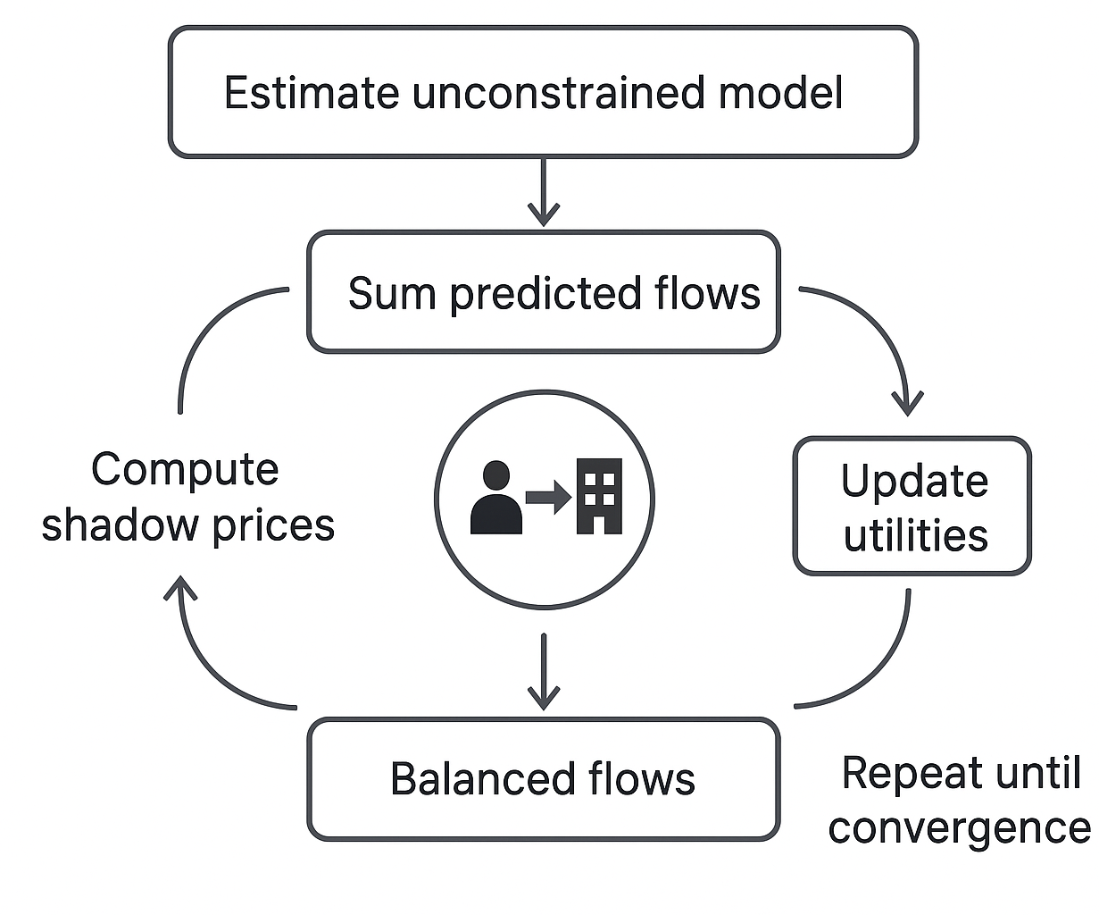
Methodological Limitations
One-sided focus on workers
It ignores employer constraints and labour market matching.
Shadow Pricing
Illustration generated by ChatGPT (OpenAI), August 2025.
extra “penalties” added to the utility of destinations that are oversaturated.
Iterative estimation: The model repeatedly updates shadow prices and recomputes choices until the flows balance with the capacity limits. (Number of jobs in relevant work sector)
Notes:
The second methodological limitation concerns capacity constraints and one-sided matching. Our model treats destination attractiveness only from the worker’s perspective, ignoring limits on how many people a destination can realistically accommodate. This can lead to unrealistic clustering at popular zones.
In simulation frameworks, this is often addressed with shadow prices. Shadow pricing is a post-estimation adjustment where destination utilities are modified based on their capacity.
In simple terms: we first estimate the unconstrained model, sum predicted flows for each destination, compare them to actual capacities, compute a correction factor, called the shadow price, and then adjust the utilities iteratively until flows match capacity.
Importantly, shadow pricing must be integrated into aggregated flows across all synthetic agents in the model. It cannot be applied only using survey data, because survey data alone does not capture the full distribution of travel demand across the population.
We did not implement shadow pricing here due to lack of reliable capacity data at the necessary resolution, high computational demands, and because our focus was on improving behavioral specification and variable selection rather than fully balanced forecasts.

Slide 31
Future Directions Methods & Implementation
Estimate multiple discrete classes each with their own utility parameters.
Activity-based realism
Limit alternatives
Data-driven specification
Latent classes
Add time-compatibility & trip-chain feasibility.
Combine deterministic top-K selection with probabilistic sampling.
Use ML for feature discovery and residual patterns; convert top interactions to utility terms.
Notes:
The finding of this study can be extended to other modes as I think the suggested improvements are quite independant to the car use.
Add activity & time constraints Model destinations as part of a person’s whole-day schedule. Require that a chosen workplace fits the worker’s time window (start/end times) and in interaction with other trips.
Limit alternatives — top-K + probabilistic sampling Reduce enormous choice sets by keeping the K most plausible alternatives (by distance/attractiveness) for each agent, then add a few additional alternatives sampled proportional to attractiveness. This hybrid keeps the most likely zones while preserving variety and avoids bias from only deterministic selection. The result is much faster estimation with minimal loss in realism.
Latent classes for commuter types Estimate a small number of discrete segments (e.g., flexible workers, constrained parents, sector-matchers) with their own parameters. This captures systematic heterogeneity so the model doesn’t force one parameter set on everyone.
Use ML (gradient-boosted trees) to discover useful patterns — e.g., non-linear effects and interactions (sector × travel time) that the choice model can then include. finds complex patterns in the data by fitting many small decision trees sequentially — each new tree corrects prior errors. We use them not to replace the choice model but to discover which variables, transformations, or interactions matter most.
For example, a GBT may reveal that the effect of travel time differs strongly by sector; we can then create a simple interaction term (sector_share × travel_time) for the multinomial logit. This way we keep the model interpretable while capturing the important non-linearities the ML found.

Slide 32
Thank you for Listening.
Please feel Free to ask any question!
Notes:
Thanks to Welcoming Goudappel group, specially Tanja and Johan who were paitient and supportive along the whole process.

Slide 33
References
Ben-Akiva, M., & Lerman, S. R. (1985). Discrete choice analysis: Theory and application to travel demand. MIT Press.
Daly, A. (1982). Estimating choice models containing attraction variables. Transportation Research Part B: Methodological, 16 (1), 5–15. https://doi.org/10.1016/0191- 2615(82)90037-6
Dong, X., Ben-Akiva, M. E., Bowman, J. L., & Walker, J. L. (2006). Moving from trip-based to activity-based measures of accessibility. Transportation Research Part A: Policy and Practice, 40 (2), 163–180. https://doi.org/10.1016/j.tra.2005.03.001
Gupta, S., Vovsha, P., & Anderson, R. (2015). Choice of workplace location: Coordination between multiple workers in the household [Original work published 2015]. Transportation Research Record, 2493 (1), 48–57. https://doi.org/10.3141/2493-06
Mishra, S., Wang, Y., Zhu, X., Moeckel, R., & Mahapatra, S. (2013). Comparison between gravity and destination choice models for trip distribution in maryland. Transportation Research Record, 2344, 1–11. https://doi.org/10.3141/2344-01
Van Cranenburgh, S., Wang, S., Vij, A., Pereira, F., & Walker, J. (2022). Choice modelling in the age of machine learning – Discussion paper. Journal of Choice Modelling, 42, 100340. https://doi.org/10.1016/j.jocm.2021.100340
Van Essen, M., Goudappel & Research, I. (2024). Landelijk reizigersonderzoek 2023 [Dutch national travel survey report]. Retrieved January 11, 2025, from https://open.overheid.nl/documenten/bf7cd49b-7a71-4e8b-91a2-a74e40b84655/file
Van Lent, S. J., Ulak, M. B., Wismans, L. J., & Geurs, K. T. (2025). The impact of teleworking in hybrid job accessibility in the netherlands: A novel agent-based modelling framework. Transportation Research Part A: Policy and Practice, 196 (100). https://doi.org/10. 1016/j.tra.2025.104496
Vitins, B., & Erath, A. (2023). Destination choice modeling with spatially distributed constraints. Journal of Transport and Land Use, 16 (1), 241–265. https://doi.org/10.5198/jtlu.2023.2226
Vitins, B. J., Erath, A. L., & Axhausen, K. W. (2016). Integration of a capacity constrained workplace choice model: Recent developments and applications with an agent-based simulation in singapore. Transportation Research Record, 2564, 1–13. https://doi.org/10.3141/2564-01

Slide 34
Full Extended Model Estimation Results
Parameter | Value | Std. Err. | p-value
Size variable
ln(Total jobs) | 0.773* | 0.025 | <0.001
Sector-specific job shares
Share Care | 2.65* | 0.24 | <0.001
Share Education | 4.42* | 0.38 | <0.001
Share Hospitality/Culture/Sports | 1.63 | 1.83 | 0.374
Share Industry/Construction | 1.72* | 0.22 | <0.001
Share Office/Services | 1.93* | 0.25 | <0.001
Share Shop | -0.114 | 1.02 | 0.910
Work flexibility
TT × Flexible work | 0.015* | 0.0020 | <0.001
Household composition
TT × With child | -0.0062* | 0.0021 | 0.003
Travel time effects
Travel time (base) | -0.056* | 0.0024 | <0.001
TT × Age 30–44 | 0.0001 | 0.0035 | 0.979
TT × Age 45–64 | -0.0047* | 0.0021 | 0.024
TT × Age 65+ | -0.0077† | 0.0040 | 0.055
TT × Woman | -0.0117* | 0.0019 | <0.001
Urbanity (ref: level 1)
Level 2 (highly urban) | 0.327* | 0.081 | <0.001
Level 3 (moderately urban) | 0.415* | 0.080 | <0.001
Level 4 (low urban) | 0.326* | 0.081 | <0.001
Level 5 (not urban) | 0.099 | 0.100 | 0.322

Slide 35
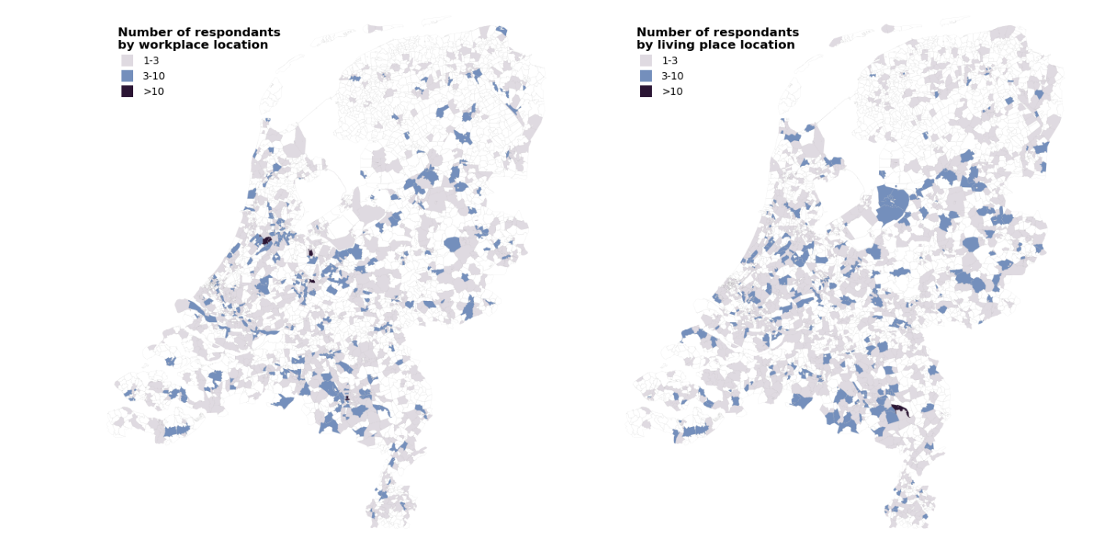
Number of resondents
By workplace location
Number of resondents
By living place location

